Slide 1
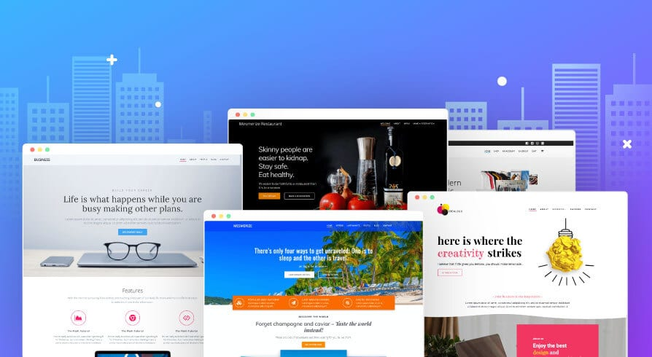
Project-Work

Slide 2
E-COMMERCE WEBSITE
PROJECT-TITLE

Slide 3


Main Page
COMPANY LOGO with Home/Main page link
Home Products About Contact Account CART
All Products
This area will display the range of all the products available on YOUR STORE
Latest Products
This area will display the range of the latest products available on YOUR STORE
Exclusive Items
This area displays some of the exclusively available items on YOUR STORE with some limited discount offer
(Footer of Web Page)
App Store Links
Useful Links for some fashion blogs
Social Media links

Slide 4
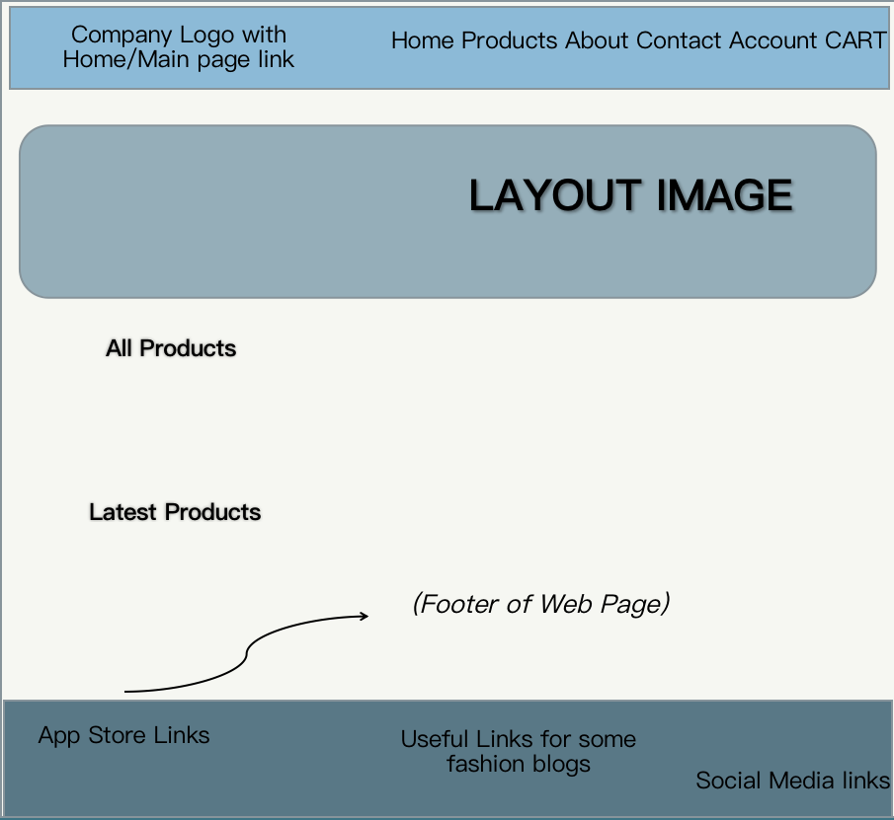
ACCOUNT-PAGE

Slide 5
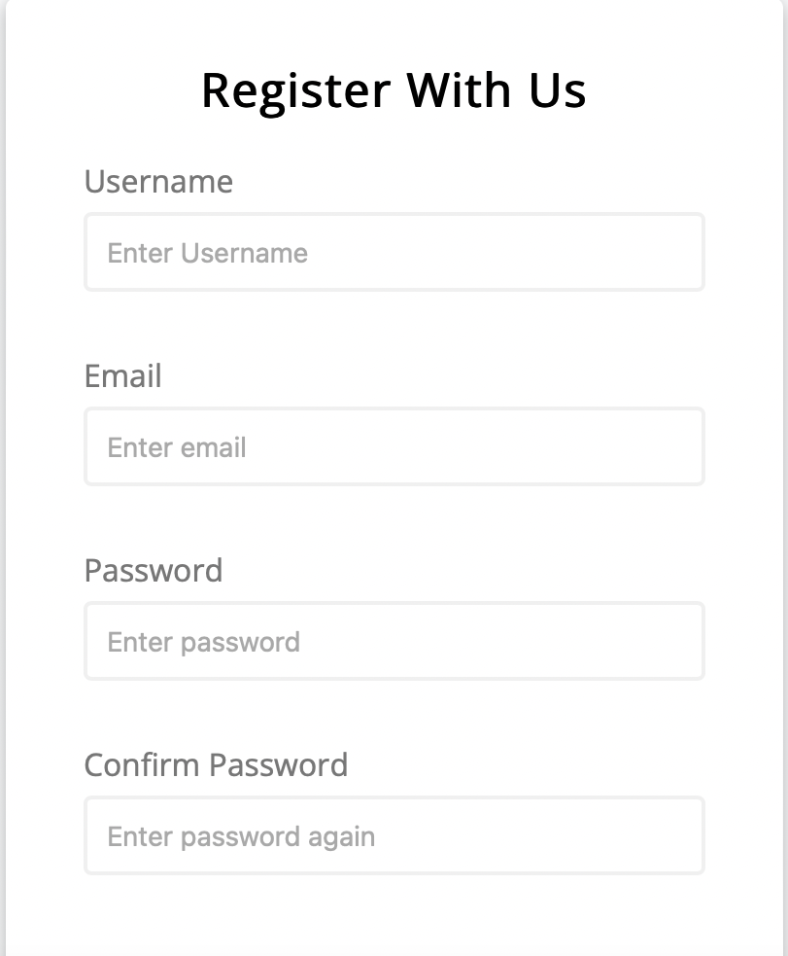
Account PAGE
The account login or signup page designed on the basis of a javascript form

Slide 6
PRODUCTS PAGE AND FINAL CHECKOUT-PAGE LEADING TO CART ITEMS AND PAYMENT PAGE
Planned features for this section:
The product page leads to all the product item with different sections and sort options.
Every product or the item in this section will have an item rating associated with it.
One can add as many items as they wish to the cart from this section and proceed to final payment gateway/page.

Slide 7
FOOTER OF WEBSITE
FOOTER
Useful links to some of the coolest fashion blogs will be provided here alongside the company's personal trademark, logo and advertising details

Slide 8
Features Of Website
The front and the main webpage enables us to search for various trending and latest products on sale.
In addition to these, we can also have a look at some of the exclusive products available on YOUR STORE.
User will be able to create an account that helps u keep track of some of the latest updates.

Slide 9

Languages Used

Slide 10
TEAM MEMBERS
Imadh Ajaz Banday 1BM20CS059
Kankshit P Bhojane 1BM20CS068
Jayam Mouneash 1BM20CS063
Jyotiraditya Singh Baghel 1BM20CS064

Slide 11
Thank YOU

